Slide 1
Asynchronous JavaScript
Introduction to promises
Example of promises
Using async/await

Slide 2
Section 1: Introduction to Promises
Overview of asynchrony
Creating a Promise object
Consuming a Promise object
Promise composition

Slide 3
Overview of Asynchrony
Asynchronous processing is commonplace in JavaScript
E.g. calling a REST service
The easiest way to manage the result is via a Promise
A Promise object represents a future value
3

Slide 4
Creating a Promise Object
Create a Promise object and pass a function as a param
In the function, do some long-running work
When done, invoke either the resolve or reject callback
let aPromise = new Promise( (resolve, reject) => {
… … …
if (successful)
resolve(someResult)
else
reject(someError)
})
4

Slide 5
Consuming a Promise Object
Client code "pins" handlers on a Promise object
then() - registers on resolved handler
catch() - registers on rejected handler
Promise also has a then() that takes two functions
The 1st function handles on resolved
The 2nd function handles on rejected
aPromise.then(result => {…})
.catch(error => {…})
5

Slide 6
Promise Composition
then() and catch() return a Promise object
So you can chain many calls to then() and catch()
This is known as "promise composition"
This is one of the main benefits of using promises
Cleaner than using traditional callbacks (which can lead to hideous nested handler functions)
aPromise.then(onResolved1)
.then(onResolved2)
.then(onResolved3)
.catch(onRejected)
6

Slide 7
Section 2: Example of Promises
Running the example
Resolving/rejecting a Promise
Resolving/rejecting many Promises

Slide 8
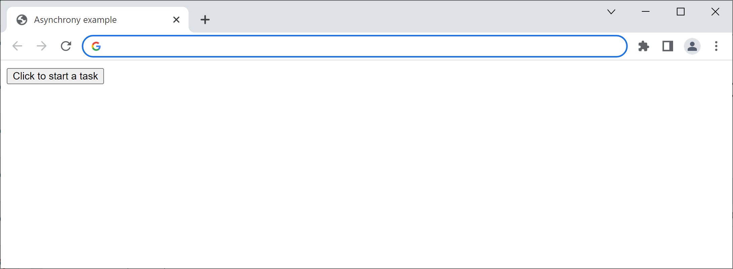
Running the Example
In this section, we run the solution for the lab - you'll see how to implement the code during the lab itself
Go to the solution folder for this lab
Open index.html in a browser
8

Slide 9
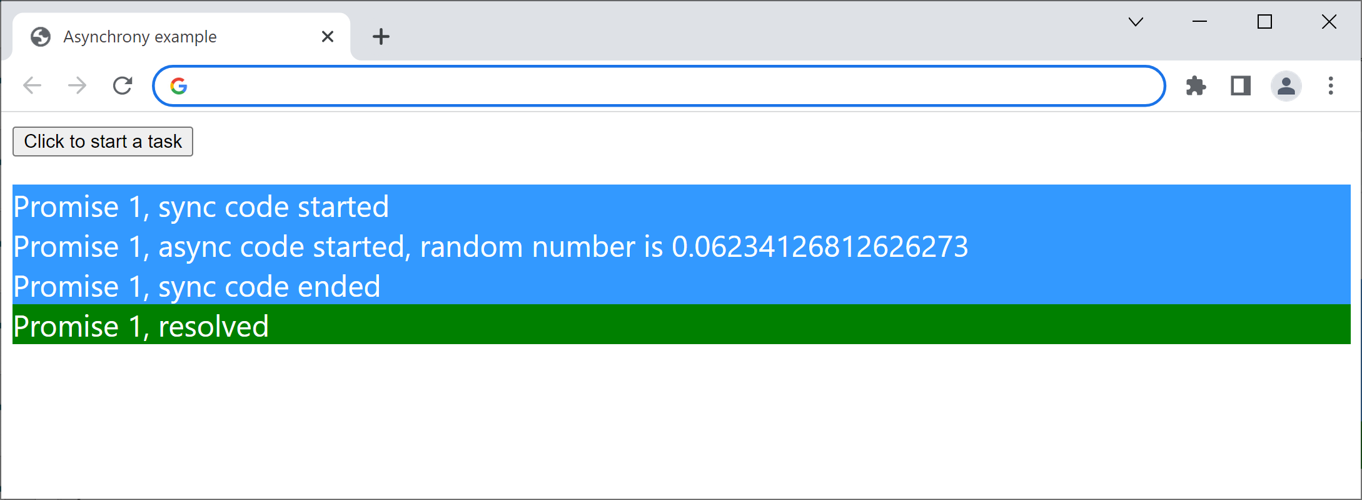
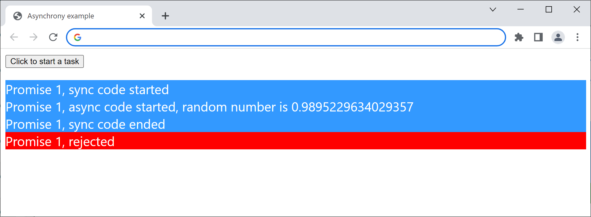
Resolving/Rejecting a Promise
Click the button. The click-handler does the following:
Generates a random number between 0 and 1
Sets up a timer, which waits for a random period
When the time is up, either resolves or rejects the promise (for the sake of the example, we resolve if the random number is < 0.5)
9

Slide 10
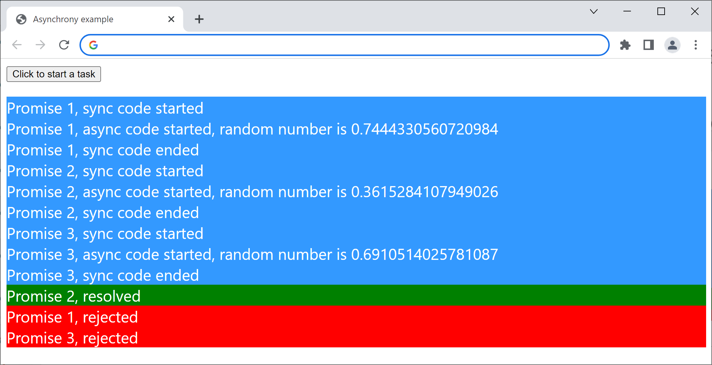
Resolving/Rejecting Many Promise's
Click the button several times in rapid succession
A new Promise object is created on each click
When each Promise is settled, it will call a handler
10

Slide 11
Section 3: Using async/await
Using of promises explicitly
The async/await keywords
Example of async/await

Slide 12
Using Promises Explicitly
Take a look at JsDeepDive/async1.js
Some functions return a Promise
We call then() to provide code to process the result
Run the example as follows:
npx babel-node async1.js
12

Slide 13
The async/await Keywords
The async/await keywords simplify promise chains
await keyword
When you call a function that returns a Promise, you can prefix the call with the await keyword
The remainder of the code in the calling function is automatically moved into a then callback
async keyword
If you use an await expression in a function, you must prefix the function declaration with the async keyword
13

Slide 14
Example of async/await
JsDeepDive/async2.js utilizes async/await
It's equivalent to the example a few slides earlier
Note these points:
It uses await rather than calling then()
The code is automatically refactored into then() chunks as appropriate - cool ☺
14

Slide 15
Summary
Introduction to promises
Example of promises
Using async/await

